Slide 1

Git Workshop
Gabriel Briones

Slide 2
Legal Notices
This presentation is for informational purposes only. INTEL MAKES NO WARRANTIES, EXPRESS OR IMPLIED, IN THIS SUMMARY.
Intel and the Intel logo are trademarks of Intel Corporation in the U.S. and/or other countries.
* Other names and brands an logos may be claimed as the property of others.
Copyright © 2016, Intel Corporation. All rights reserved.
Notes:
‹#›

Slide 3

Get Git
https://git-scm.com/downloads

Slide 4

Have you found this?
Final project
Final final project
Final final final
This is it
This is really it
UNDER VERSION CONTROL, YOUR SOURCE CODE MUST BE
definitive
Final definitive
super final project
this is it
final project 15-mar-13
last one
Last final project
very last final project
Final project v2
reviewed
Final project 4
Final project 5
Last of the latests
Final project 4.1
To clean some stuff

Slide 5
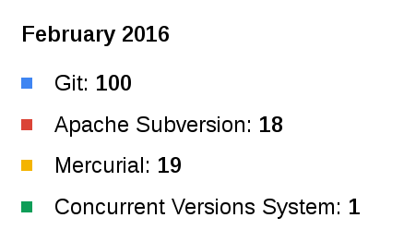
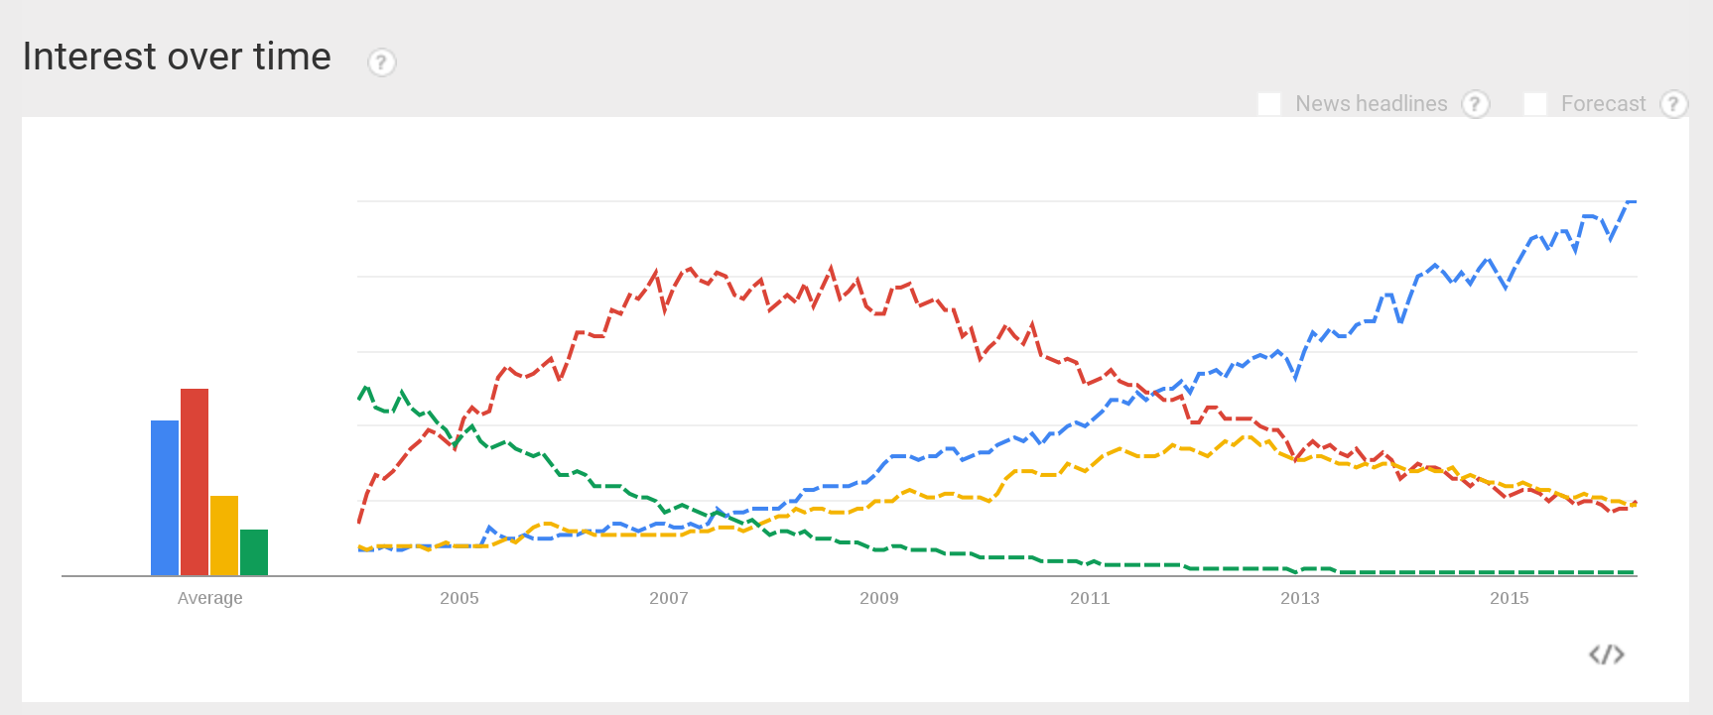
Systems popularity

Slide 6
Version control
Tag
v1.0
v1.1
v2.0
Branch
Master
Merge
Commit
Branch

Slide 7
How Git works locally
Repository
commit
Staging area
reset
reset
add/rm
Working directory

Slide 8
Naming practices
Commits:
Add feature X
Fix bug in X
Change X for Y
Remove X library
Branches:
development
mike/refactor-UI
feature-port-listing
bugfix-sync-files
Tags:
v1.0
v1.8.5.5
v0.5-beta
v1.1-rc.2

Slide 9
Hands on (Committing)
Initialize git repository
Verify repository status
Add files to empty repository
Try to create a first commit
$ git init
$ git status
$ git add <files>
$ git commit

Slide 10
Hands on (Configuring)
Configure git user’s name
Configure git user’s email
Verify user configuration
Create a first commit
View first commit
$ git config --global user.name <name>
$ git config --global user.email <email>
$ git config --global --list
$ git commit
$ git log

Slide 11
Hands on (Branching)
Create a new branch
Checkout the new branch
Verify current branch
Commit a change
Checkout master
Merge into master
Show last commit
$ git branch <branch>
$ git checkout <branch>
$ git branch
$ git commit -a
$ git checkout master
$ git merge <branch>
$ git show

Slide 12
Hands on (Merging)
Commit a change in a file in a branch.
Checkout master and commit another change in the same file.
Merge the branch into master.
Resolve conflicts and commit merge.

Slide 13
Hands on (Tagging)
List tags
Create tag
Create tag with annotation
Create tag of old commit
$ git tag
$ git tag <tag>
$ git tag -a <tag> -m <message>
$ git tag <tag> <commit>

Slide 14
Hands on (Rebasing)
Show current commit
Move to older commit
Create a new branch from there
Stage files and commit the change
Rebase from master
Solve conflicts
Continue rebasing
Checkout master
Merge new branch into master
$ git show
$ git checkout <commit>
$ git checkout -b <branch>
$ git rebase master
$ git rebase --continue
$ git merge <branch>

Slide 15
Hands on (Reverting)
Delete branch
Remove all files from staging area
Remove some files from staging
Undo all file changes
Undo some files changes
Checkout a previous commit
Undo file changes until a commit
Untrack files, remove from repo
Add more changes to last commit
$ git branch -d <branch>
$ git reset
$ git reset <files>
$ git reset --hard
$ git checkout <files>
$ git reset <commit>
$ git reset <commit> --hard
$ git rm <files>
$ git commit --amend

Slide 16
How Git works remotely
Remote repository
pull/clone
fetch
push
Local repository
commit
Staging area
reset
reset
add/rm
Working directory

Slide 17


Git remote host repository
GitHub is a Web-based Git repository hosting service. It offers all of the distributed revision control and source code management (SCM) functionality of Git as well as adding its own features.
GitLab is a web-based Git repository manager with wiki and issue tracking features. GitLab offers hosted accounts similar to GitHub, but also allows its software to be used on third-party servers.

Slide 18















What can I found in Github.com?

Slide 19
Hands on (Cloning)
Clone remote repository
Verify remote host
Commit a change in repo
Upload commits to remote repo
Create a new branch
Upload branch to remote repo
Create README.md in github
Download changes to local repo
Delete local branch
Download remote branch
$ git clone <repository>
$ git remote -v
$ git push
$ git push -u origin <branch>
$ git pull
$ git checkout -b <branch> origin/<branch>

Slide 20
How github forking works
Github origin
pull request
fetch
push
fork
pull/clone
Local repository
Github upstream
fetch upstream
commit
Staging area
reset
reset
Working directory

Slide 21
Hands on (Forking)
Fork a repo in github
Clone a repo branch
Add upstream remote location
Verify remote locations
Commit a change in upstream
Verify upstream branches
Download upstream changes
Merge upstream changes
Commit a new change
Upload local changes
Create a pull-request in github
$ git clone -b <branch> <repo>
$ git remote add upstream <repo>
$ git remote -v
$ git branch -a
$ git fetch upstream/<branch>
$ git merge upstream/<branch>

Slide 22
Hands on (Patching)
Commit a signed change
Create a patch of your last commit
Send email with your patch
Reset hard to previous commit
Apply your patch
$ git commit -s -m <message>
$ git format-patch -1
$ git send-email -1 --to=<email>
$ git apply <patch>

Slide 23
Hands on (Releasing)
Create a release in Github

Slide 24
Q&A
Notes:
Attending:
Absent:

